Slide 1
FishSense - Low Power Mode
Project Overview - Rahul Polisetti, Mohana Seelan, Kyle Yang

Slide 2
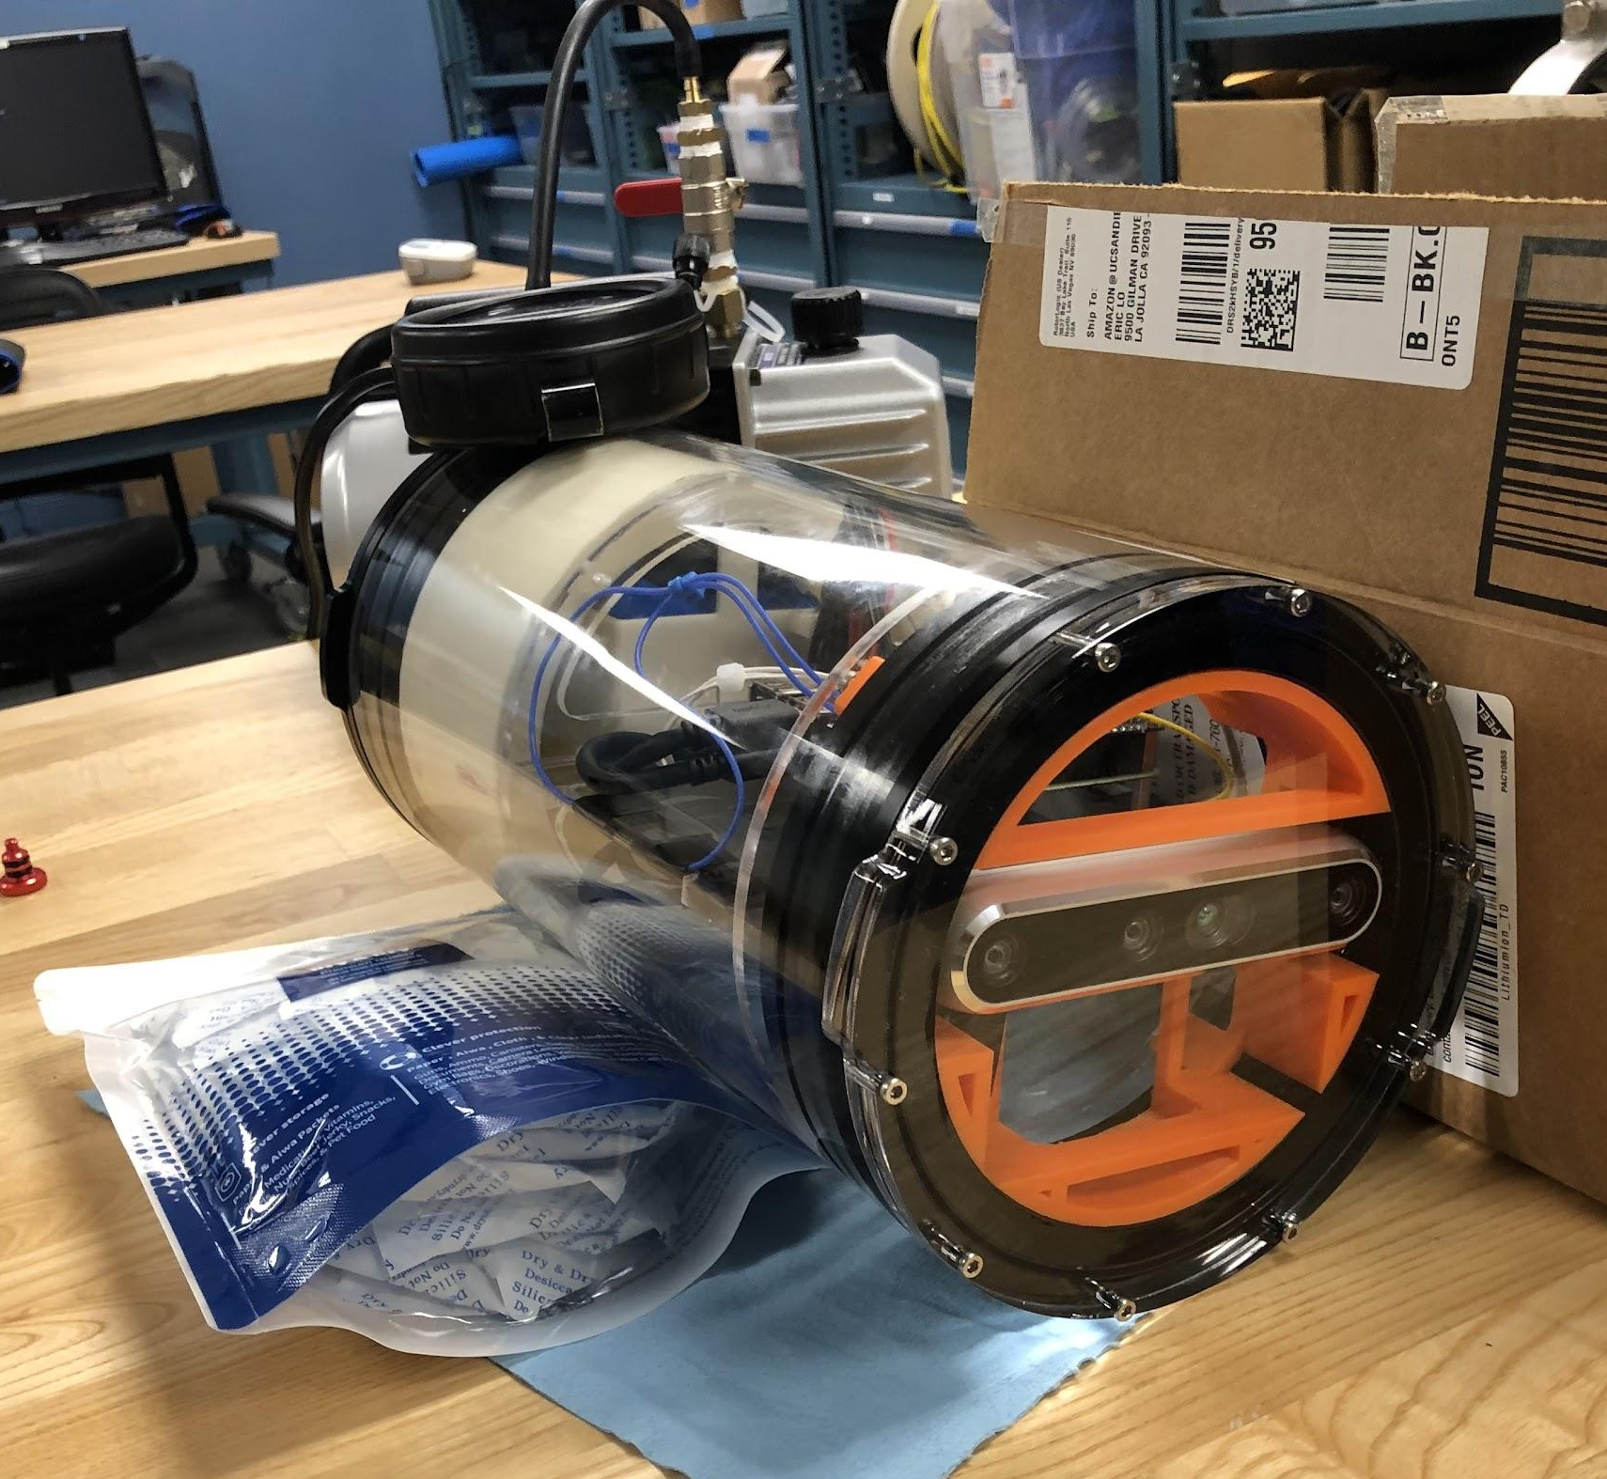
Introduction
FishSense is a compact form-factor underwater camera data capture module
Project Goal: Improve Fishsense system to achieve longer deployment windows
Problems with current system:
Battery Capacity
High power consumption
Limited SSD size
Irrelevant data (non-activity, bubbles, etc.)
Notes:
Long deployment windows include 1-2 week autonomous deployment, with 5-10% active time recording.

Slide 3
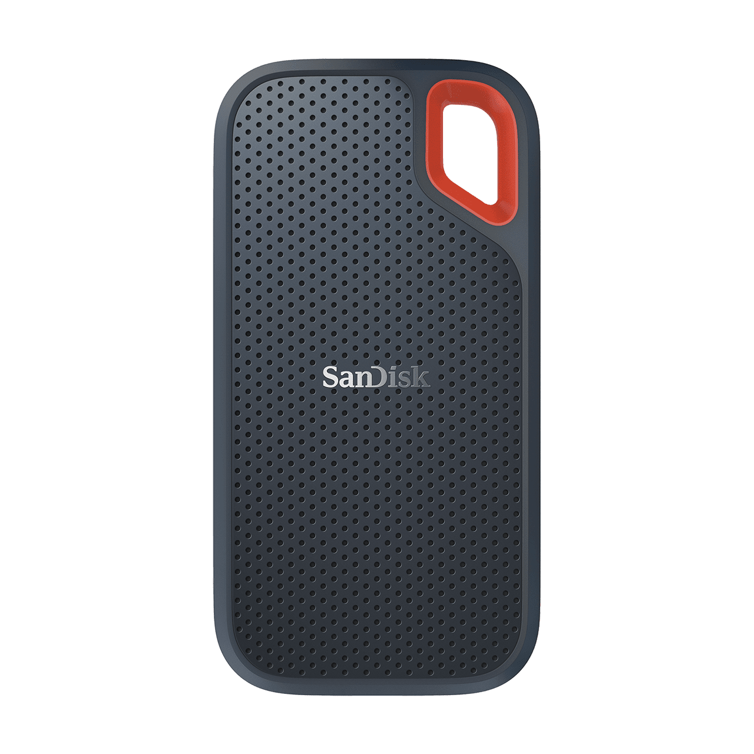
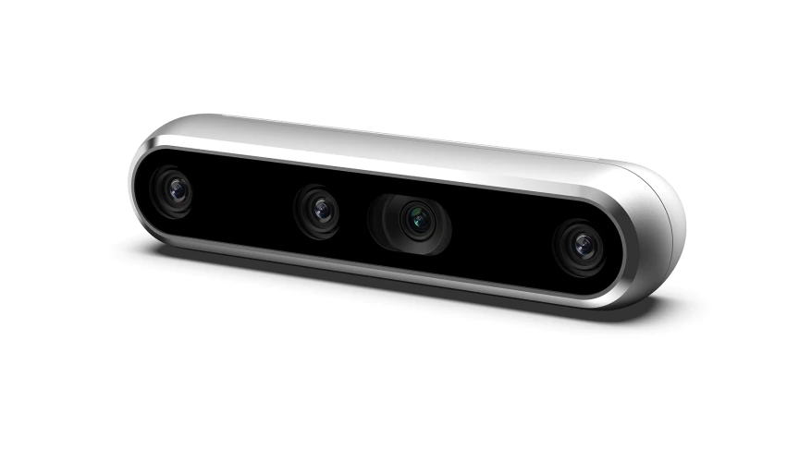
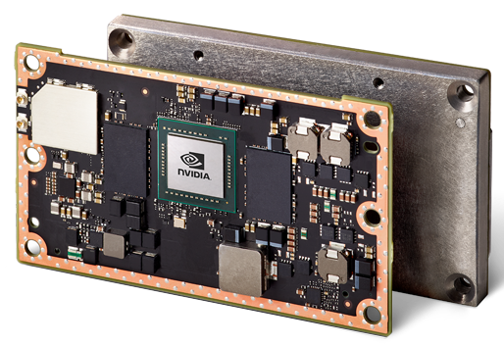
Current Hardware
Notes:
NVIDIA Jetson TX2 is an embedded system-on-module (SoM) with dual-core NVIDIA Denver2 + quad-core ARM Cortex-A57, along with an integrated 256-core Pascal GPU

Slide 4
Solution
No Fish Activity
Active
Sleep (low power)
Detected fish activity
Notes:
The solution that we’ve developed is to switch between a high-power and a low-power state, depending on whether there is high activity versus low activity around the capsule. We plan on using auxiliary sensors to sense when there are fish around or not around the capsule.

Slide 5
Solution Breakdown
Part 1: Auxiliary sensor for state transition
Real Sense camera too power hungry
Find the best auxiliary sensor that works underwater
Send interrupt to firmware to trigger between Sleep (low power) and Active
Package additional sensor, create additional daughter board if needed
Part 2: Create a sleep state in firmware (low power)
Turn the entire system off
Turn off cores, GPU
Slow down clock speed
Turn off certain parts of the system (RealSense, SSD)
Part 3: Add additional batteries
Increase tube size to accommodate batteries
Notes:
Sensors we are currently thinking of using are Ultrasonic, Sonar, Laser, Thermal

Slide 6
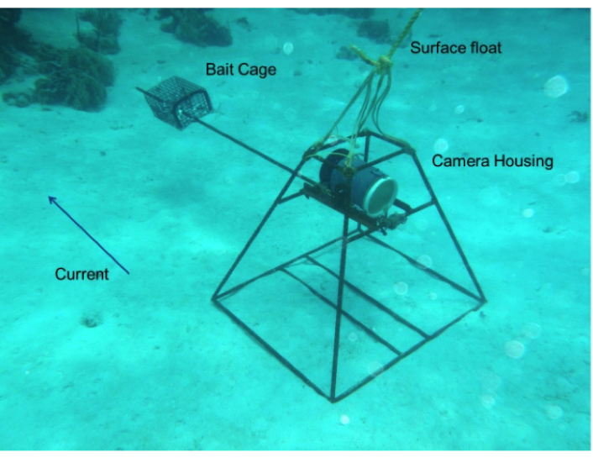
Current System
Updated System
Consistent recording lasts around 2 hours
1.5tb SSD card gets full 5Gb a minute
Goal: Last around 1-2 weeks
To sense fish activity to enable/disable high-power systems to capture data
Capable firmware to power the low-power sensor system as well as switch to the high-power camera system
Larger battery containment to house more batteries (mechanical)
Bait frame to hold bait to lure fish toward the capsule (mechanical)

Slide 7
Schedule
Week 3: research and compile list of sensors to test, and rampup on existing hardware
Week 4: bring in multiple sensors and start underwater testing, start firmware development
Week 5: low power state firmware development, daughter board development (if needed)
Week 6: sensor firmware integration and development
Week 7: sensor hardware integration and testing
Week 8: hardware/software debugging and testing
Week 9: field testing and wrap up

Slide 8
Thank You

